Slide 1
Practical Exercise
Developing Your Inventory Plan

Slide 2
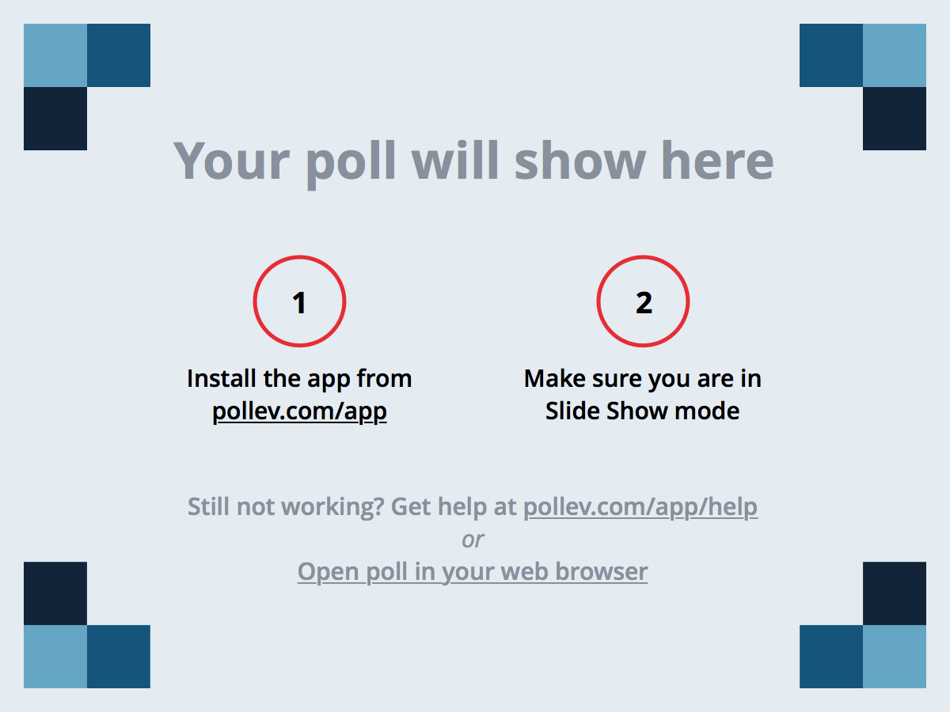
Notes:
Poll Title: What is the most important thing to remember about volunteer tree inventories? https://www.polleverywhere.com/free_text_polls/hcwfI3e0w1u5nJf

Slide 3
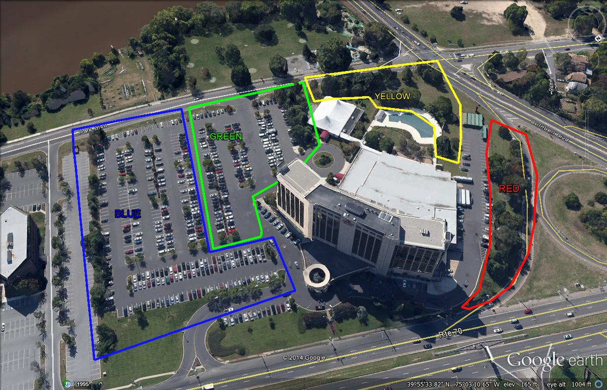
Quick Review from Yesterday
What unexpected issues did you encounter?
How did you address these issues?
How could it apply to inventory in your town?

Slide 4
Group Exercises
Break into your groups from yesterday
Describe a pizza

Slide 5
Group Exercises
In your groups from yesterday, discuss the homework assignment and collaborate to agree on an inventory plan for the group.
Designate a group leader and be prepared to present your inventory plan.

Slide 6
Group Presentations
Yellow
Blue
Green
Red

Slide 7
Group Presentations
Discuss group consensus and compare to recommended volunteer data set.

Slide 8
EAB / Ash Survey
Specific Problem…
Emerald Ash Borer
Complete a simple, specific problem inventory
Identify the location and diameter of all ash trees (by genus)
Use i-Tree default diameter classes

Slide 9
Notes:
Poll Title: Which of these is an ash tree? https://www.polleverywhere.com/multiple_choice_polls/I69A3TqzKyaindT

Slide 10
Share your data!
Use the i-Tree Species Codes – These are the same as the USDA NRCS (Natural Resources Conservation Service) PLANTS database.
Quercus rubra = QURU
Norway maple = ACPL
Ash = FR
Use standardized diameter classes, if possible.

Slide 11
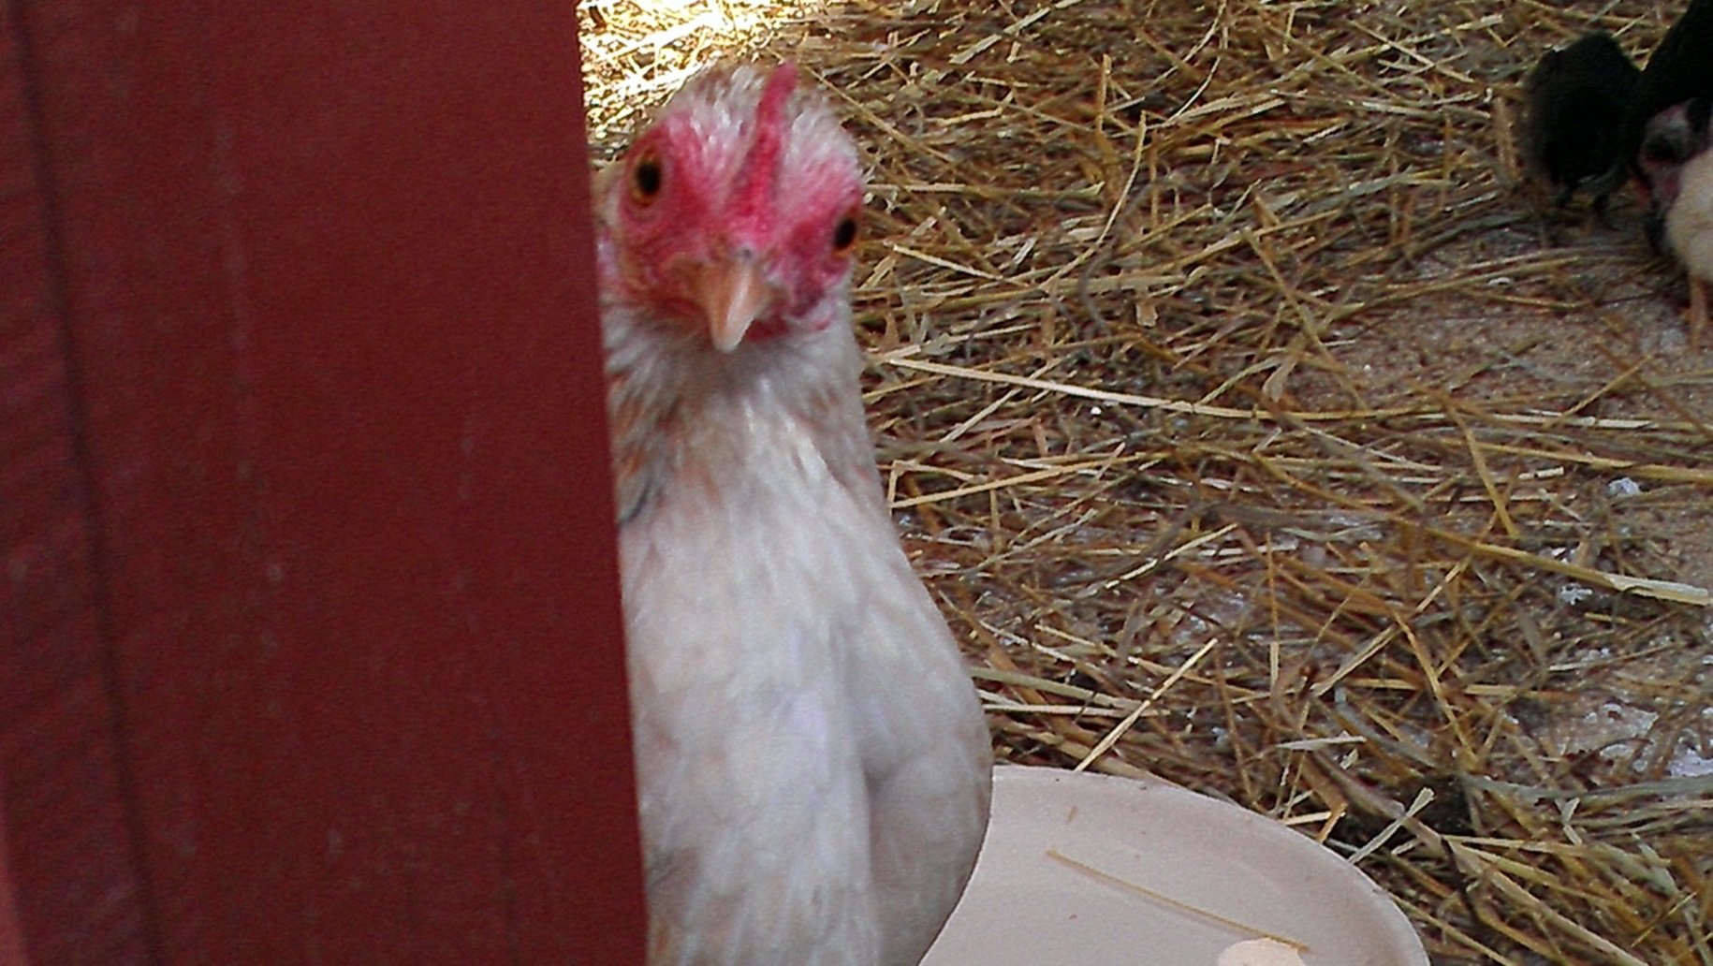
Any Questions?

